Slide 1
Comprehensive Analysis of Sales, Products, and Customers for Amazon E-commerce website
Presented by
Priyanka Dutta Mondal | S8524 | DS42

Slide 2
Objectives and Methodology
Objectives: Understand product performance, sales trends, and customer behavior.
Methodology:
Data Wrangling: Cleaning and preparing data.
Feature Engineering: Adding insightful columns (timeofday, dayname, monthname).
Exploratory Data Analysis (EDA): Answering key business questions.

Slide 3
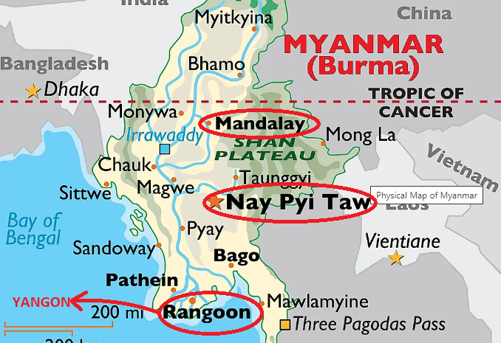
Cities and Branches
Country - Myanmar
Branch - A
Yangon
Branch - B
Mandalay
Branch – C
Naypyitaw

Slide 4

Important Insights
Product Line Analysis
Highest revenue making product
Food and beverages (also incurred highest VAT)
Sports and travel
Electronic accessories
Fashion accessories
Home and lifestyle
Health and beauty

Slide 5

Important Insights
Product Line Analysis
Average rating of each product
Food and beverages -> 7.11
Fashion accessories -> 7.03
Health and beauty -> 7
Electronic accessories -> 6.92
Sports and travel -> 6.92
Home and lifestyle -> 6.84

Slide 6

Important Insights
Sales Analysis
Highest revenue generated month
January (116291.86) ( Sports and travel product line)
March (109455.50)
February (97219.37)

Slide 7
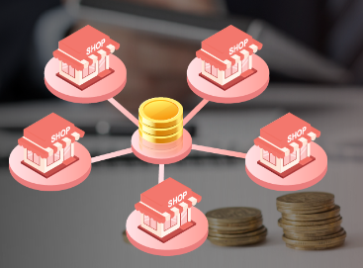
Important Insights
Sales Analysis
Highest sales done by Branch
Naypyitaw (110568.71) (capital)
Yangon (106200.37)
Mandalay (106197.67)

Slide 8

Important Insights
Sales Analysis
Time of the day sales occur more
Afternoon session is the most busiest session when purchasing of product is occurring more.
Night time purchasing is very less compare to other session.

Slide 9



Important Insights
Highest Frequency Of Payment Methods
1
2
3
E-Wallet
Cash
Credit Card

Slide 10


Important Insights
Customer Analysis
Members are purchasing more then normal customer
Member
Normal

Slide 11


Important Insights
Customer Analysis
Yangon Mandalay Naypaitaw
Male
179
Female
161
Male
170
Female
162
Female
178
Male
150
1
2
In general female are predominate member among customer

Slide 12
Conclusion
So here are the main key factors whose are effecting the business across the branches in Myanmar
Product line quality
Time and Day
Customer relationship
Payment methods
Branch performance
Customer type
We should take strategies on the basis of above point to gain more profit from our business.

Slide 13
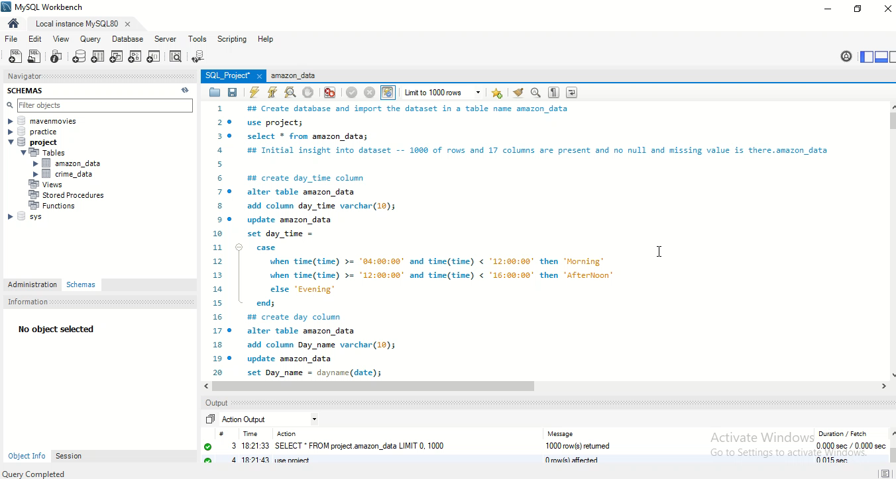
Recording of my coding session
IDE – MySQL Workbench and Language - SQL

Slide 14

Thank you

Slide 15

Q & A Session

